Slide 1
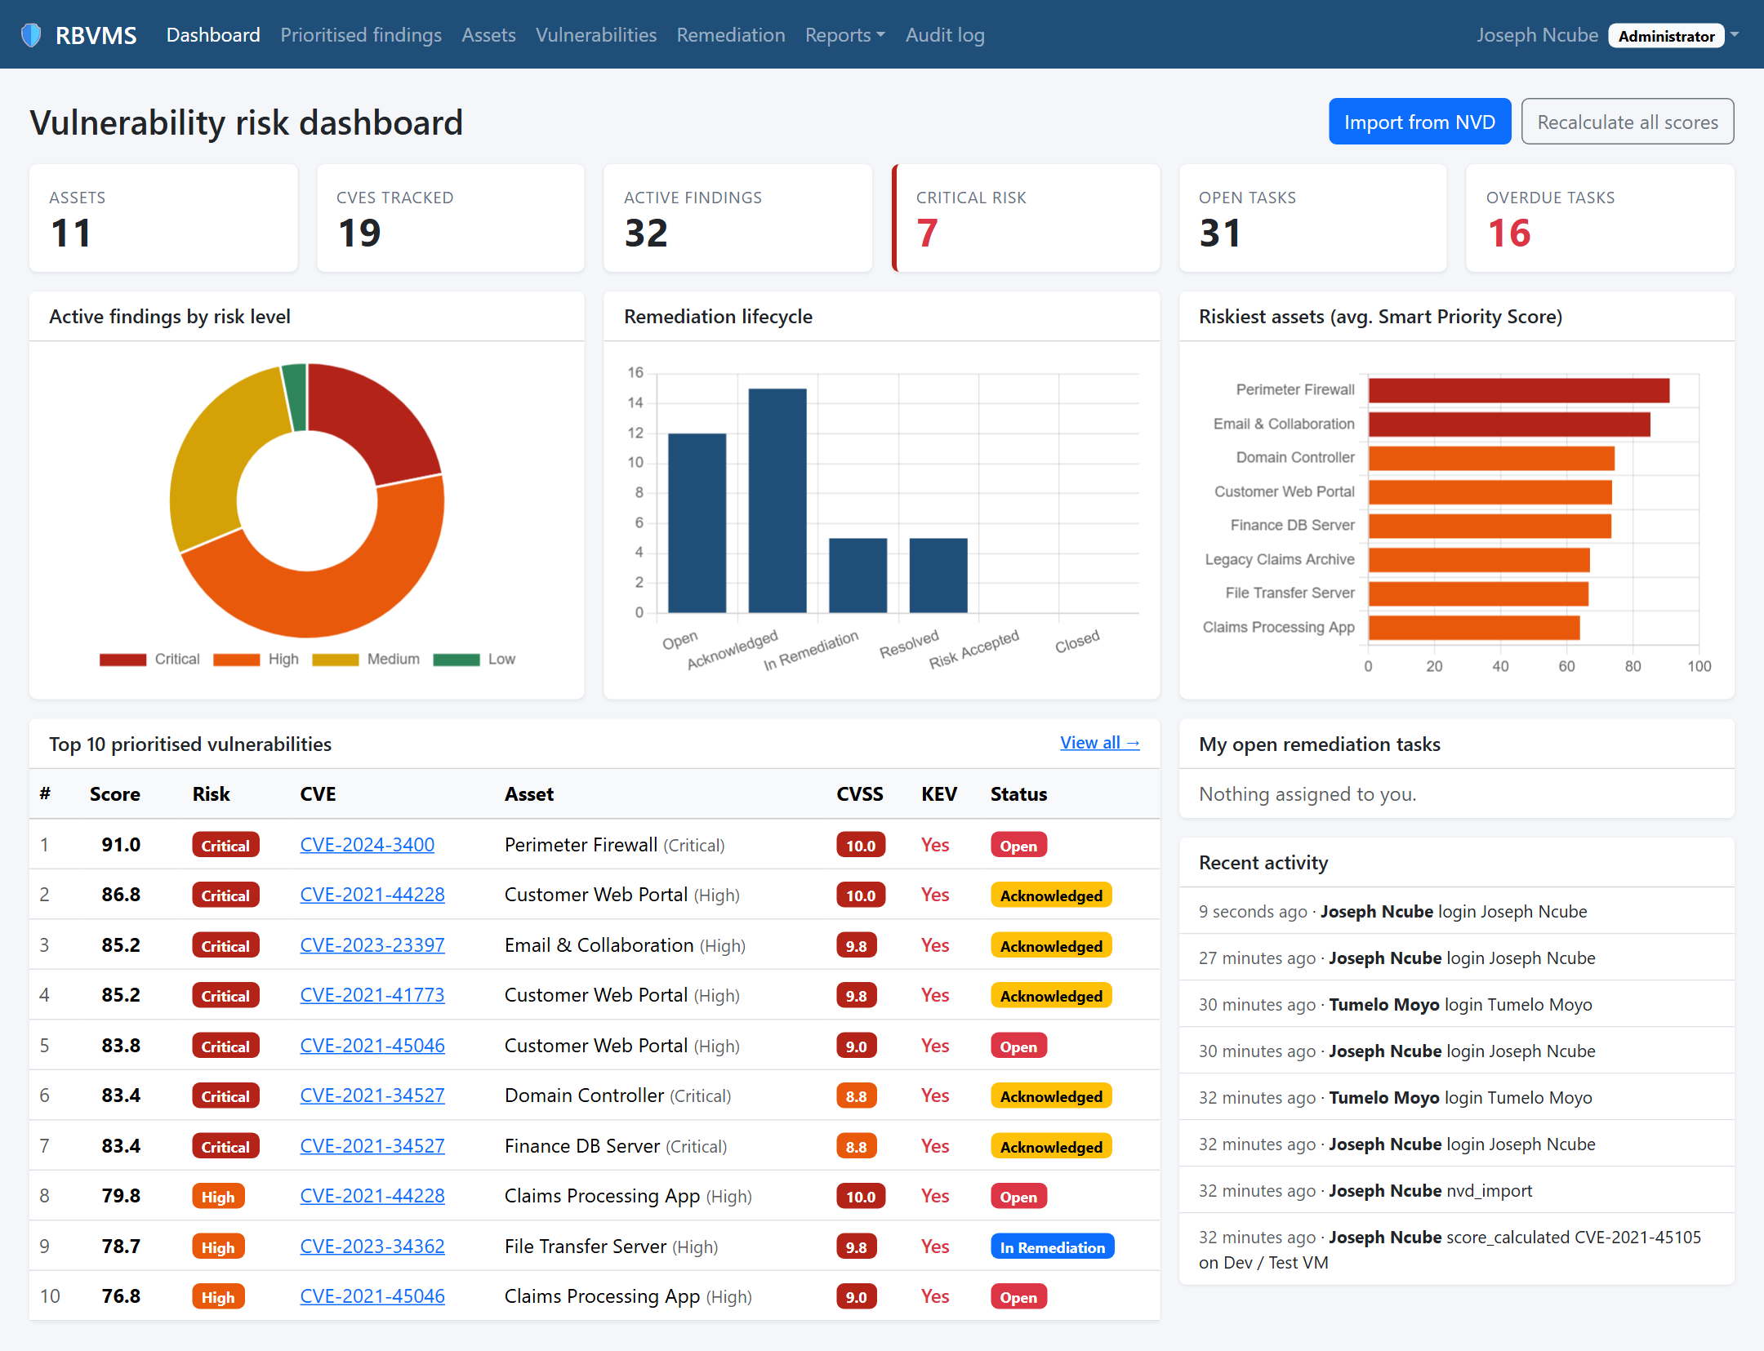
SETUP AND RUN GUIDE
Running RBVMS on Your PC
Risk-Based Vulnerability Assessment and Management System: the tools, environment and every command you need, explained.
Riana Matengu | BSc (Hons) Network Security and Computer Forensics
Notes:
This deck explains how to install, configure and run the RBVMS project on a Windows PC, and lists every command with what it does.

Slide 2
How the system fits together
Four parts run on your PC; one comes from the internet.
Web browser
Django web app
MySQL 8.0
NVD API
Edge or Chrome
Python 3.12 in a virtual environment
Windows service MySQL80
nvd.nist.gov (internet)
You use the app at
http://127.0.0.1:8000
Pages, Smart Priority
Score, NVD import
Database rbvms:
assets, CVEs, findings
Real CVE records
and CVSS scores
Your files live in C:\Users\riana\OneDrive\Desktop\final project. The code is also on GitHub.
Secrets such as the database password are kept in the .env file, which is never uploaded to GitHub.
Bootstrap and Chart.js (page styling and charts) are loaded from the internet, so keep a connection while using the app.
Notes:
The browser talks to the Django app, Django stores everything in MySQL, and imports live vulnerability data from the NVD.

Slide 3
Tools you need
All of these are already installed on your PC. Install commands are for a new PC.
Tool | On your PC | Used for | Install on a new PC
Python | 3.12.10 | Runs the Django web app | winget install -e --id Python.Python.3.12
Git | 2.55 | Downloading the code from GitHub | winget install -e --id Git.Git
MySQL Server | 8.0.45 (service MySQL80) | The database | MySQL Installer 8.0 from dev.mysql.com/downloads/installer
MySQL Workbench | 8.0 (optional) | Viewing the database, running SQL scripts | winget install -e --id Oracle.MySQLWorkbench
VS Code | Installed (optional) | Reading and editing the code | winget install -e --id Microsoft.VisualStudioCode
Web browser | Edge / Chrome | Using the app | Built into Windows
Python packages (Django, mysqlclient, requests and others) are not installed system-wide: they live in the project's venv folder and are listed in requirements.txt.
Notes:
winget is the Windows package manager and comes with Windows 11. MySQL is installed with Oracle's own installer, which also sets the root password and creates the MySQL80 service.

Slide 4
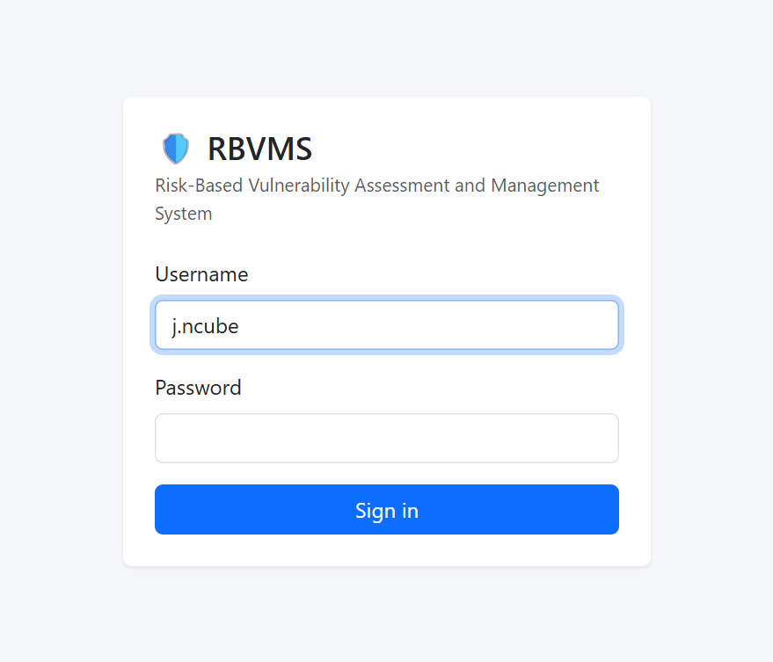
Quick start on this PC
Everything is already set up. Three steps to a running system.
1
Open the project folder
Desktop \ final project
2
Double-click start.bat
Or run .\start.bat in a terminal. Leave the black window open.
3
Sign in at 127.0.0.1:8000
j.ncube Administrator, or t.moyo Analyst. Password: DEMO_PASSWORD in .env
To stop: press Ctrl+C in the black window.
Notes:
start.bat checks the MySQL service, starts the Django server on port 8000 and opens the browser after a few seconds.

Slide 5
PART 2
First-time setup on a new PC
1
Install the tools
4
Create the MySQL database
2
Get the code
5
Configure the .env file
3
Create the Python environment
6
Build the tables and load data
Notes:
Only needed when setting the project up on a different computer. On this PC these steps are already done.

Slide 6
Step 1: Install the tools
Run in PowerShell. winget downloads and installs each tool.
PowerShell or Command Prompt
MySQL Server 8.0
# Python and Git
> winget install -e --id Python.Python.3.12
> winget install -e --id Git.Git
# Optional: editor and database viewer
> winget install -e --id Microsoft.VisualStudioCode
> winget install -e --id Oracle.MySQLWorkbench
# Close the terminal, open a NEW one, then check:
> python --version
Python 3.12.10
> git --version
git version 2.55.0.windows.5
Download MySQL Installer 8.0 from dev.mysql.com/downloads/installer.
Choose "Server only" (add Workbench if you like).
Set a strong root password and keep it safe.
Leave "Configure MySQL Server as a Windows Service" ticked so it starts with Windows.
Notes:
A new terminal is needed because installers add Python and Git to PATH, which only new terminals see.

Slide 7
Step 2: Get the code
Download the project from GitHub into a folder called "final project".
PowerShell or Command Prompt
> cd $HOME\Desktop
> git clone https://github.com/riamatt-glitch/final.git "final project"
> cd "final project"
manage.py
requirements.txt
.env.example
start.bat
Django's command tool. Every "manage.py ..." command in this guide runs it.
The exact Python packages and versions the project needs.
Template for your settings file. Copy it to .env (Step 5).
Double-click to run the app. setup.bat and test.bat are the other helpers.
Notes:
git clone copies the repository from GitHub. The .env file with passwords is not in the repository, so it has to be created.

Slide 8
Step 3: Create the Python environment
A virtual environment keeps this project's packages separate from the rest of the PC.
PowerShell or Command Prompt
Package | Why
Django 5.2 | Web framework
mysqlclient | Talks to MySQL
requests | Calls the NVD API
python-dotenv | Reads .env
pytest-django | Runs the tests
# Create the environment (a folder called venv)
> python -m venv venv
# Install the packages listed in requirements.txt
> venv\Scripts\python.exe -m pip install -r requirements.txt
Always run the project through venv\Scripts\python.exe so it uses these packages.
Shortcut: setup.bat runs Steps 3, 5 (creates .env) and 6 for you.
Notes:
pip is Python's package installer. The versions are pinned in requirements.txt so every PC gets the same versions.

Slide 9
Step 4: Create the MySQL database
Creates the rbvms database and an app user that can only use that database.
1
Open setup_mysql.sql in Notepad or VS Code and replace choose-a-strong-password with a new password.
setup_mysql.sql
# What setup_mysql.sql does
CREATE DATABASE rbvms
CHARACTER SET utf8mb4;
CREATE USER 'rbvms'@'localhost'
IDENTIFIED BY '<your password>';
GRANT ALL PRIVILEGES
ON rbvms.* TO 'rbvms'@'localhost';
2
In MySQL Workbench, open the Local instance connection (user root, port 3306).
3
Choose File > Open SQL Script > setup_mysql.sql, then click the lightning bolt to run it.
Or from Command Prompt (it asks for the root password):
Command Prompt (cmd.exe)
> "C:\Program Files\MySQL\MySQL Server 8.0\bin\mysql.exe" -u root -p < setup_mysql.sql
Notes:
The < redirect works in Command Prompt, not PowerShell. The app never uses the root account; it uses the limited rbvms user.

Slide 10
Step 5: Configure the .env file
Your private settings. Create it from the template, then edit it in Notepad or VS Code.
PowerShell or Command Prompt
Setting | Meaning
DB_ENGINE | mysql, or sqlite to run without MySQL
DB_PASSWORD | The rbvms password chosen in Step 4
NVD_API_KEY | Optional free key: 10x faster NVD imports
DEMO_PASSWORD | Password given to the demo users
DJANGO_SECRET_KEY | Long random string (signs sessions)
DJANGO_DEBUG | True on your PC; False on a server
> copy .env.example .env
> notepad .env
# Lines to set for MySQL:
DB_ENGINE=mysql
DB_NAME=rbvms
DB_USER=rbvms
DB_PASSWORD=<from Step 4>
DB_HOST=127.0.0.1
DB_PORT=3306
Never upload .env to GitHub: .gitignore already excludes it.
Notes:
Request an NVD API key at nvd.nist.gov/developers/request-an-api-key. Without one, the NVD allows 5 requests per 30 seconds.

Slide 11
Step 6: Build the tables and load data
Run these once, from the project folder.
PowerShell or Command Prompt
migrate
# Create all tables in MySQL
> venv\Scripts\python.exe manage.py migrate
# Load the demo organisation (fast, offline)
> venv\Scripts\python.exe manage.py seed_demo
# ...or with real CVE data from the NVD (slower)
> venv\Scripts\python.exe manage.py seed_demo --live
# Optional: your own administrator account
> venv\Scripts\python.exe manage.py createsuperuser
Reads the models and creates the six project tables plus Django's own tables.
seed_demo
11 fabricated assets, 17 public CVEs and three users: j.ncube, t.moyo, k.sebina.
createsuperuser
Asks for a username, email and password for a new admin account.
Notes:
seed_demo --live fetches each CVE from the NVD and can take a few minutes because of the NVD rate limit.

Slide 12
Running it day to day
MySQL starts with Windows. You only need to start the web app.
PowerShell or Command Prompt
# Start (or double-click start.bat)
> cd "$HOME\OneDrive\Desktop\final project"
> venv\Scripts\python.exe manage.py runserver
Starting development server at
http://127.0.0.1:8000/
Open http://127.0.0.1:8000 in your browser.
Stop: press Ctrl+C in the server window.
Different port: manage.py runserver 8001
Notes:
The development server reloads automatically when a code file changes. It is meant for your own PC, not for a public server.

Slide 13
Working with vulnerability data
Run from the project folder. Prefix each with venv\Scripts\python.exe manage.py
Command | What it does
import_nvd --cve CVE-2021-44228 | Import one CVE from the NVD, match it to assets and score it
import_nvd --keyword "apache http server" --max 50 | Import up to 50 CVEs matching a keyword
import_nvd --days 7 | Import CVEs published in the last 7 days (good for a daily task)
import_nvd --kev --max 200 | Import CISA Known Exploited Vulnerabilities
rescore | Recalculate every Smart Priority Score
seed_demo --reset --live | Delete and rebuild the demo data from live NVD records
generate_load_data --count 5000 | Add 5,000 synthetic findings for performance testing
generate_load_data --clear | Remove the synthetic findings again
The NVD can take over a minute per request. The import waits up to 2 minutes and tries 3 times.
Notes:
The same import is available in the web app under Vulnerabilities > Import from NVD (administrators only).

Slide 14
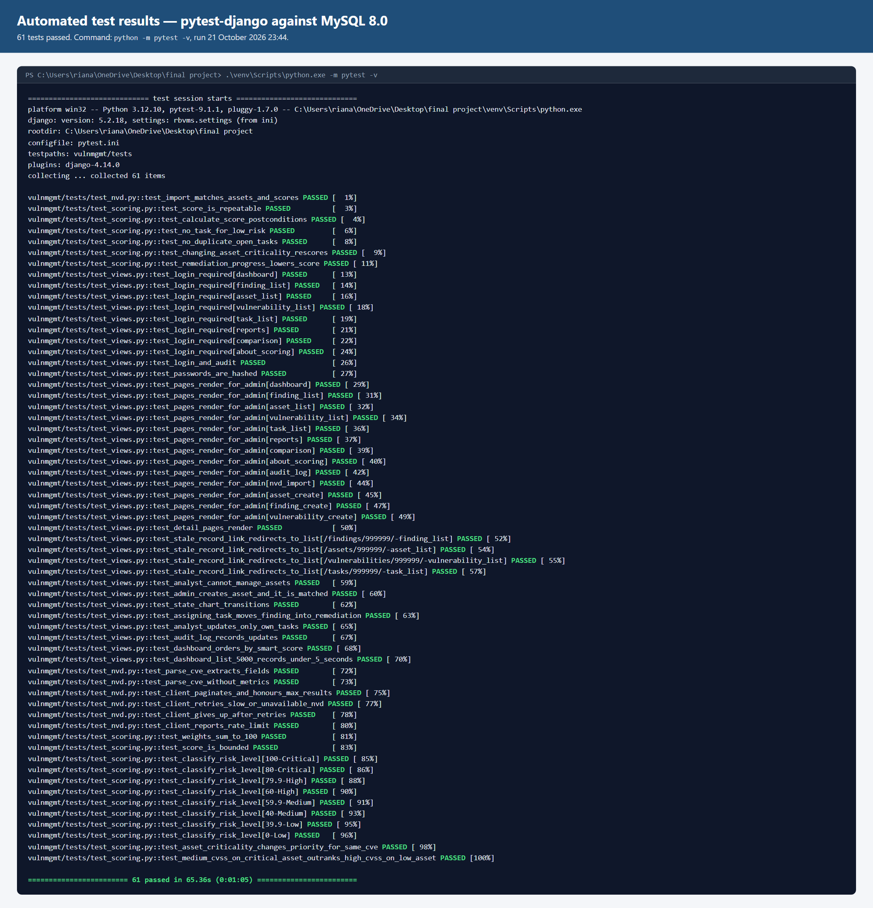
Testing the system
The automated test suite checks scoring, security, the NVD client and the web pages.
PowerShell or Command Prompt
# Run all tests (or double-click test.bat)
> venv\Scripts\python.exe -m pytest
.............................................
61 passed in 65.36s
Uses a temporary test_rbvms database, so your data is never touched.
Covers the Smart Priority Score, password hashing, role-based access, the remediation state chart and the 5,000-record list.
Add -v to list every test by name.
Notes:
Expect 61 passed. Any failure prints the test name and the reason.

Slide 15
Users, roles and passwords
Two roles: Administrators manage everything; Analysts work on their own tasks.
Administrator
Security Analyst
PowerShell or Command Prompt
# New admin account
> venv\Scripts\python.exe manage.py
createsuperuser
# Reset a forgotten password
> venv\Scripts\python.exe manage.py
changepassword j.ncube
Add and edit assets
Import from the NVD
Change finding status
Assign tasks; view the audit log
View dashboard, findings and reports
Update tasks assigned to them
Cannot change assets or settings
Add users and set their role: sign in as an administrator, open your name (top right) > Admin / users, or go to http://127.0.0.1:8000/admin/.
Change your own password: your name (top right) > Change password.
Notes:
Passwords are stored as salted PBKDF2 hashes, never in plain text.

Slide 16
Troubleshooting
The most likely problems and how to fix them.
If you see... | Do this
"python" is not recognized | Open a new terminal after installing Python. If it persists, reinstall Python with "Add to PATH".
start.bat: MySQL80 service is not running | Open the Services app, find MySQL80, click Start. Or as administrator: net start MySQL80
(1045) Access denied for user 'rbvms' | DB_PASSWORD in .env must match the password in setup_mysql.sql.
That port is already in use | A server is already running: use that window, or run manage.py runserver 8001.
NVD import times out or "rate limit" | Wait 30 seconds and retry; add an NVD_API_KEY to .env.
Pages have no styling or charts | Check your internet connection: Bootstrap and Chart.js load online.
"That finding no longer exists" | The page was opened before the data changed: refresh it.
Notes:
Most problems come from the MySQL service being stopped or the .env password not matching the database user.

Slide 17
Where things are
The main folders and files in the project.
Folder tree
scoring.py
final project\
manage.py
requirements.txt
.env (your settings)
setup.bat start.bat test.bat
rbvms\ settings, URLs
vulnmgmt\
models.py database tables
scoring.py Smart Priority
nvd.py NVD API client
views.py web pages
templates\ page layouts
tests\ automated tests
screenshots\ evidence images
The Smart Priority Score: weights, risk levels and remediation deadlines.
nvd.py and services.py
Fetch CVEs from the NVD and match them to assets.
README.md
Short written version of this guide, on GitHub too.
Riana_Matengu; chapter 1, 2, 3, 4.docx
The project report with Chapter 4.
Notes:
Open the folder in VS Code (File > Open Folder) to browse the code.

Slide 18
Command cheat sheet
Run in Command Prompt from the project folder. venv\Scripts\activate makes "python" use the project's packages.
Every day
First-time setup
Data and users
start.bat
test.bat
Ctrl+C (stop server)
venv\Scripts\activate
python manage.py
runserver
python -m pytest
setup.bat
python -m venv venv
venv\Scripts\activate
pip install -r
requirements.txt
copy .env.example .env
python manage.py migrate
python manage.py seed_demo
venv\Scripts\activate
python manage.py import_nvd
--cve CVE-2021-44228
python manage.py rescore
python manage.py
createsuperuser
python manage.py
changepassword <user>
Notes:
Activating the environment (venv\Scripts\activate in Command Prompt) makes python and pip mean the project's own copies. Without activating, type venv\Scripts\python.exe in place of python, as on the earlier slides.

